Slide 2
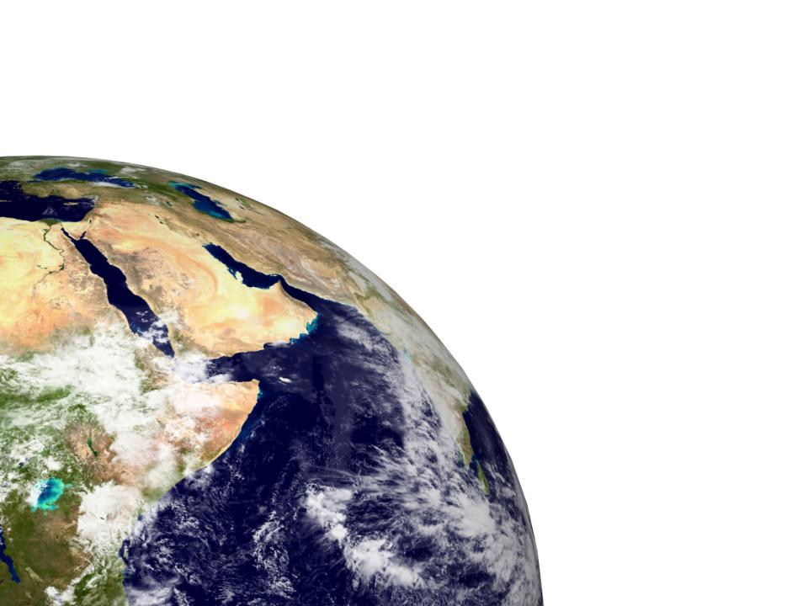
Be holy because I,
the LORD your God,
am holy.
Leviticus 19:2

Slide 3
‘You must keep the Israelites from things that make them unclean, so they will not die in their uncleanness for defiling my dwelling place, which is among them’
Leviticus 15:31

Slide 4
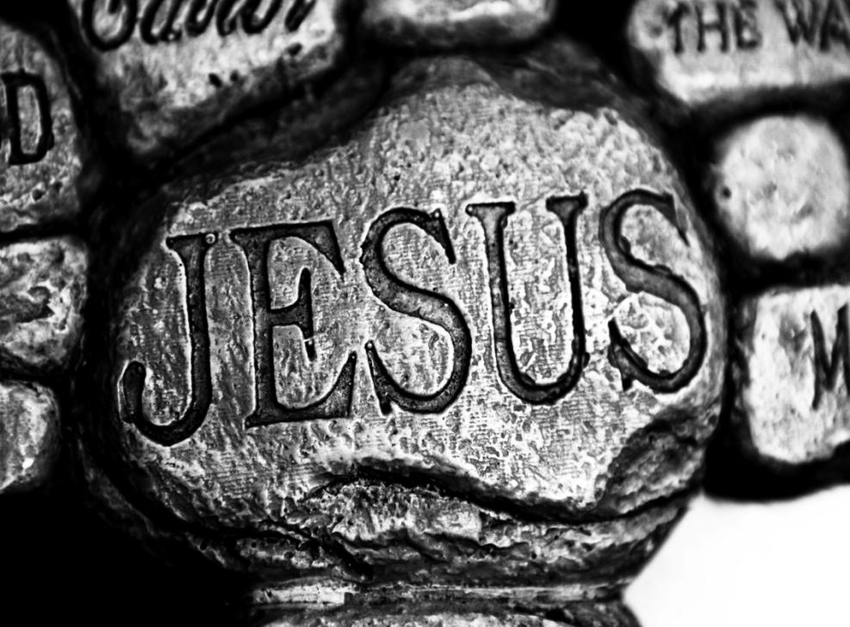

Slide 5
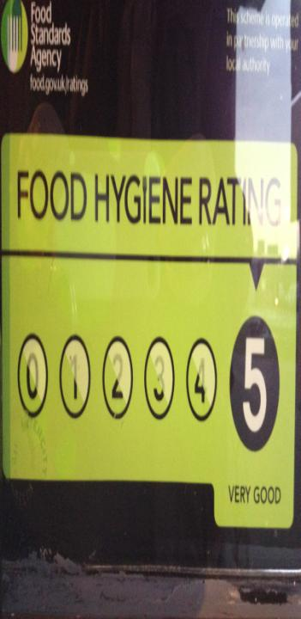
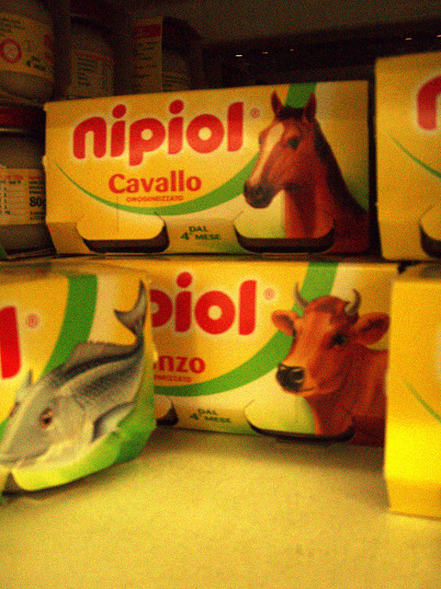

Slide 6
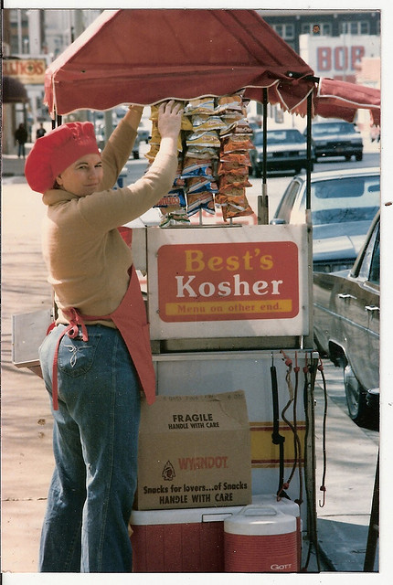
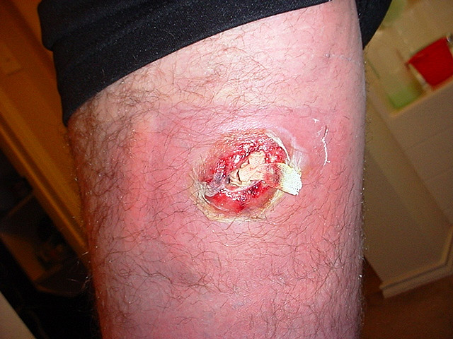
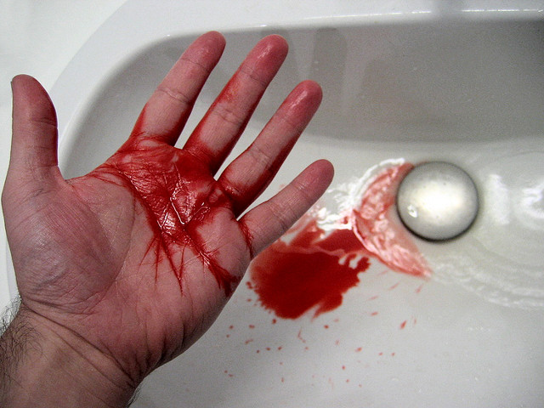

Slide 7
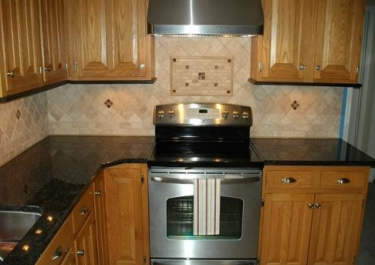
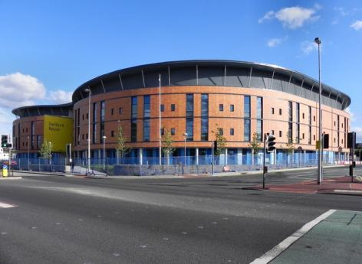
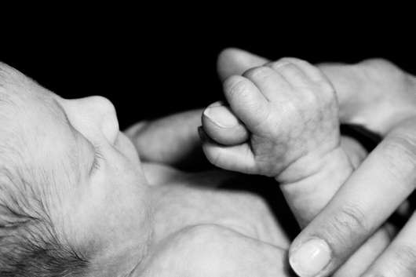
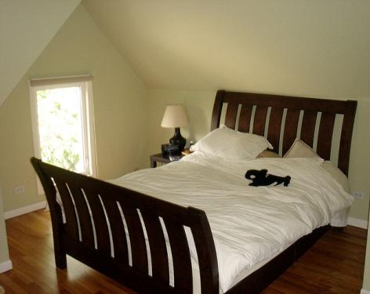

Slide 8
Holy:
Used by God
Clean; Whole; Complete
Unclean; Polluted; Incomplete
Sacrifice – Washing

Slide 9
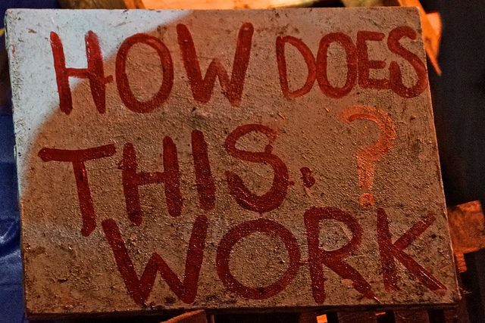

Slide 12
If anyone is in Christ, he is a new creation; the old has gone, the new has come! All this is from God, who reconciled us to himself and gave us the ministry of reconciliation: God was reconciling the world to himself in Christ, not counting men’s sins against them. …
We implore you on Christ’s behalf: be reconciled to God. God made him who had
no sin to be sin for us, so that in him
we might become the
righteousness of God’
2 Cor 5:17ff

