Slide 1
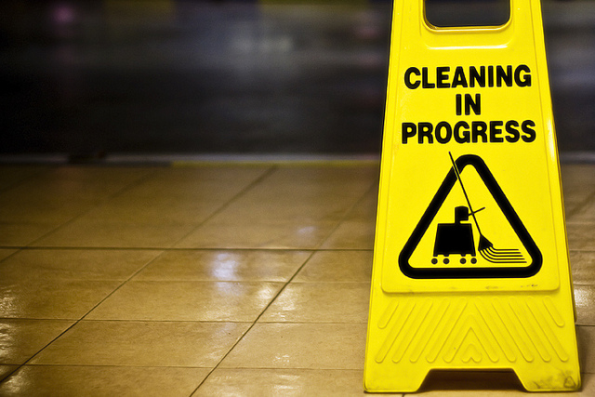
Day of Atonement

Slide 3
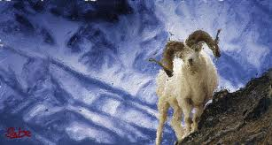

Slide 4
Sin Spoils Things

Slide 5
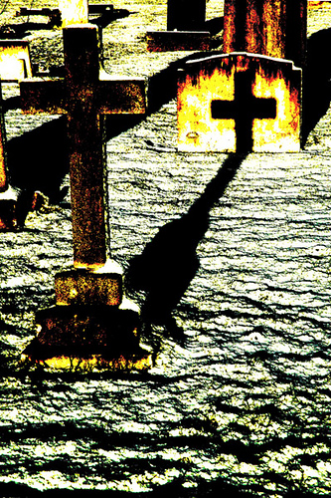
Reflections in Hebrews
Every Year Once for all (9:6-14)
Special Priest Everyone enters (10:19)
Priest is sinner Jesus is sinless (7:26)
Sin persistently Sin dealt
separates with (10:1-18)
Goats killed Jesus carries the sin;
& scapegoat goats relieved
leaves

