Slide 1
So what did you expect?
Singleness to look like?

Slide 2
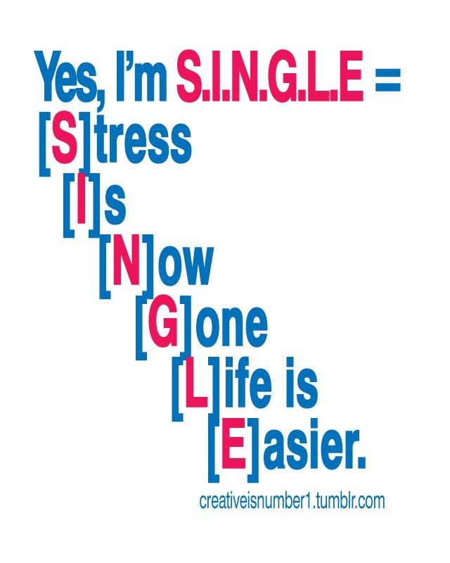

Slide 5
⁷ I wish that all of you were as I am. But each of you has your own gift from God; one has this gift, another has that.

Slide 6
“within the Church we need to shatter the power of the myth that … only marriage offers the conditions necessary for human fulfillment. We must work with compassion at recovering a vision for singleness as an authentic vocation.”

Slide 7
Singleness
The fight….
The natural desires
The loneliness
The hopes
The daring big picture offered by Jesus
Mark 10:28-31
1 Cor 7:32-36
1 Cor 7:7
The Art

Slide 10
³ Do nothing out of selfish ambition or vain conceit. Rather, in humility value others above yourselves, ⁴ not looking to your own interests but each of you to the interests of the others.

