Slide 1
The Book of Daniel
Seeing Differently, Acting Differently
The writing’s on the wall: Daniel 5

Slide 2
God’s at work

Slide 3
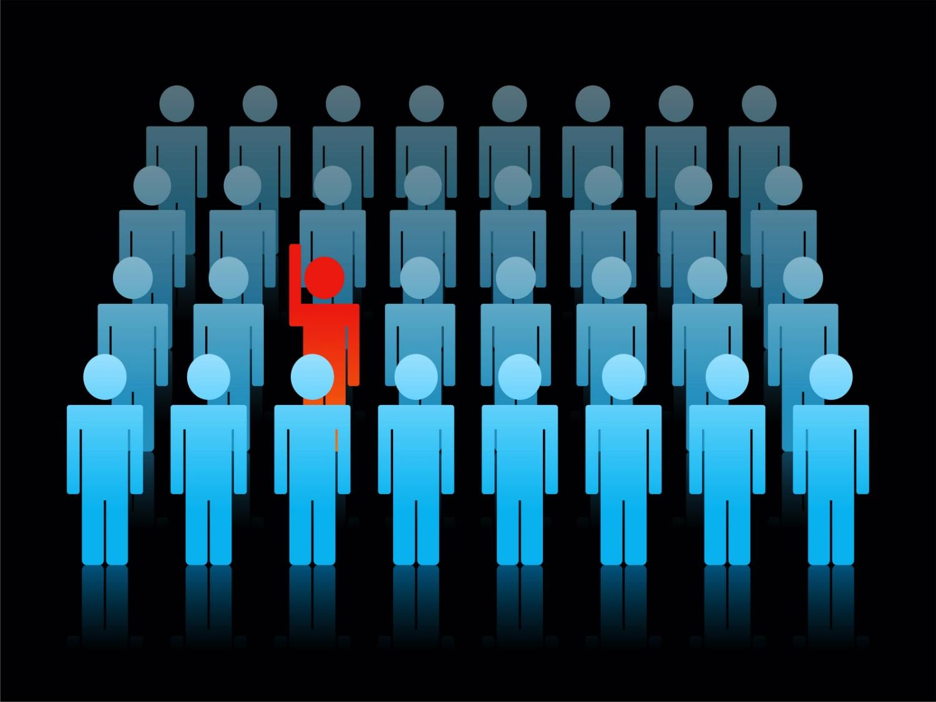
¹¹ There is a man in your kingdom who has the spirit of the holy gods in him.

Slide 4
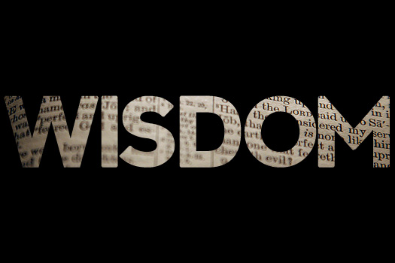
Wisdom is godly skill in everyday living

Slide 5
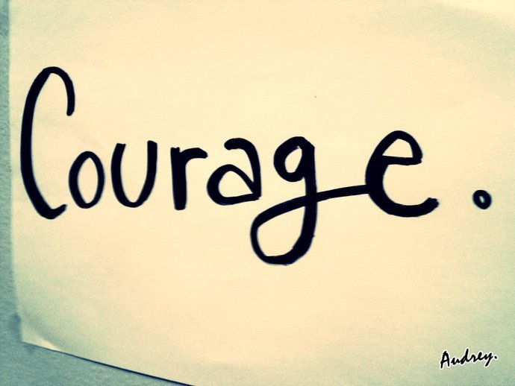

Slide 6
“Courage is fear that has said its prayers”
Dorothy Bernard

Slide 7
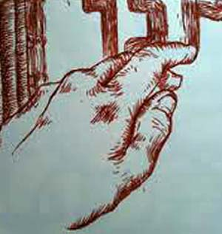
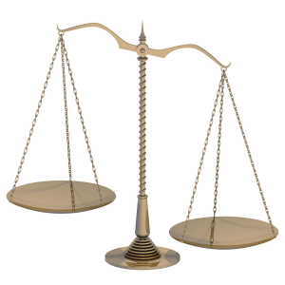
Mene, Mene, Tekel, Parsin

Slide 9
God’s at work

Slide 10
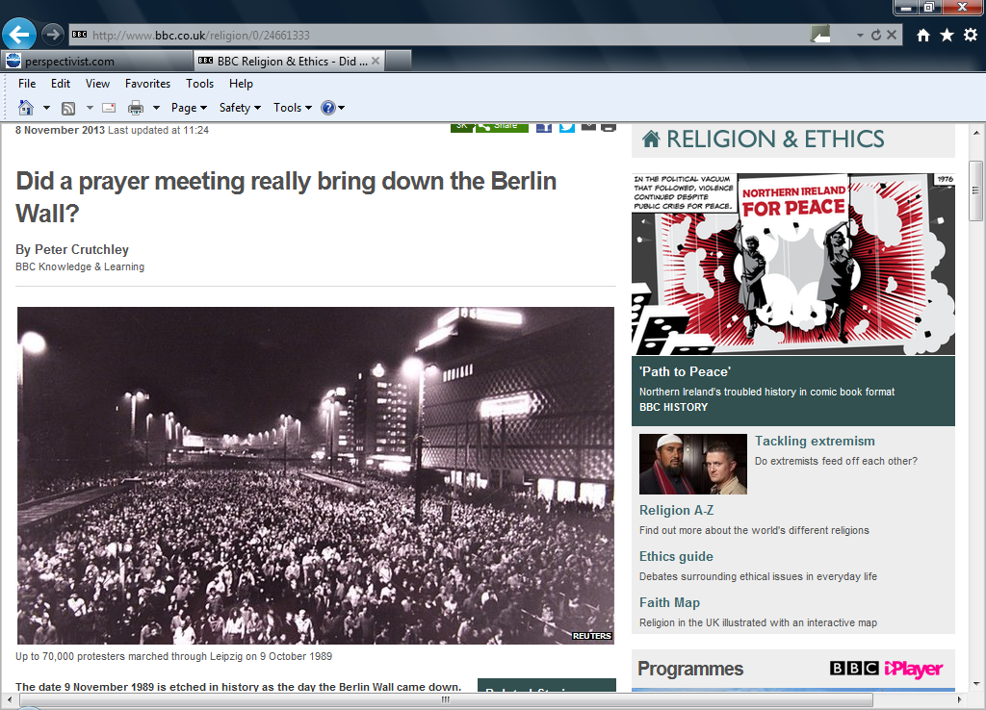

Slide 11
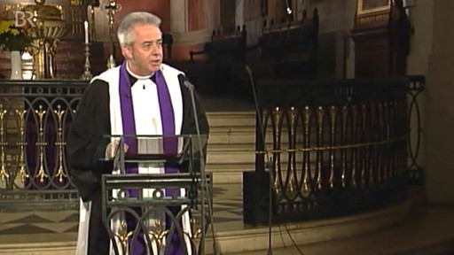
“What moved me the most was that people who had grown up in two atheist dictatorships - first the Nazis then the communist regimes - were able to distil the message of Jesus into two words: no violence.
"Without the church it would have been like all other revolutions before - bloody and unsuccessful."
“We did it because the church has to do it"

