Slide 2
Five Books:
One Message
Genesis
Exodus
Leviticus
Numbers
Deuteronomy

Slide 3
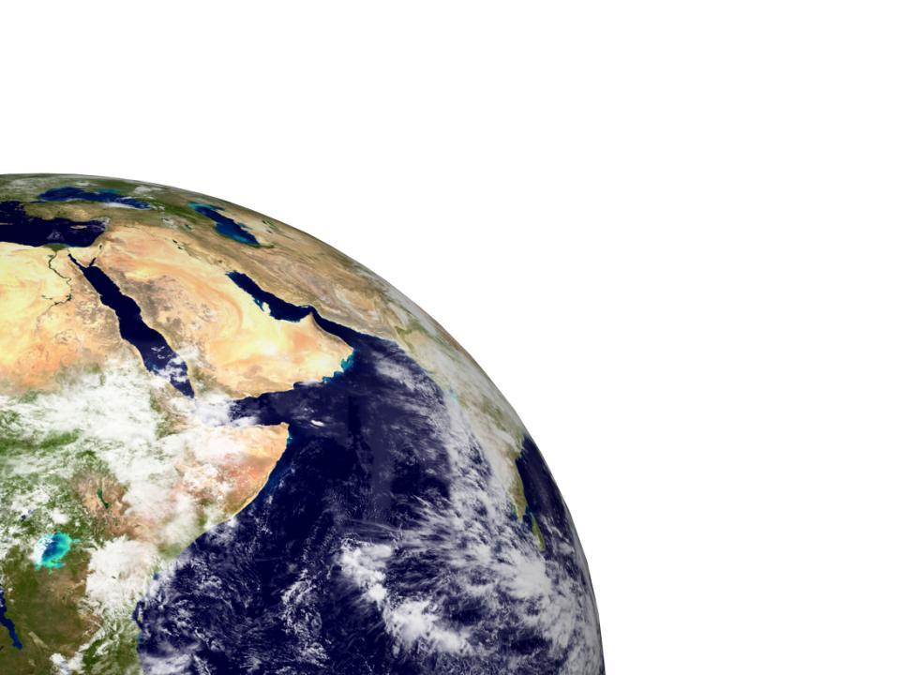
Be holy because I,
the LORD your God,
am holy.
Leviticus 19:2

Slide 5
³⁴ Then the cloud covered the tent of meeting, and the glory of the Lord filled the tabernacle. ³⁵ Moses could not enter the tent of meeting because the cloud had settled on it, and the glory of the Lord filled the tabernacle.
³⁶ In all the travels of the Israelites, whenever the cloud lifted from above the tabernacle, they would set out; ³⁷ but if the cloud did not lift, they did not set out – until the day it lifted. ³⁸ So the cloud of the Lord was over the tabernacle by day, and fire was in the cloud by night, in the sight of all the Israelites during all their travels.

Slide 6
The Lord called to Moses and spoke to him from the tent of meeting. He said, ² ‘Speak to the Israelites and say to them: “When anyone among you brings an offering to the Lord, bring as your offering an animal from either the herd or the flock.

Slide 7
A Holy People who get it wrong: chapters 1-8

Slide 8
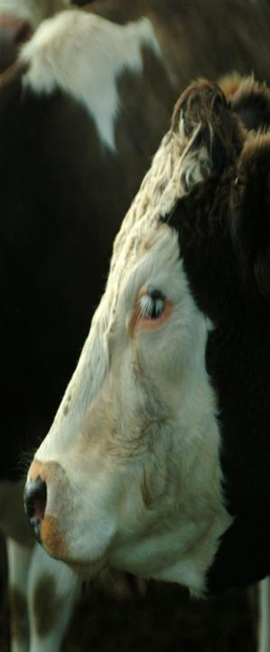
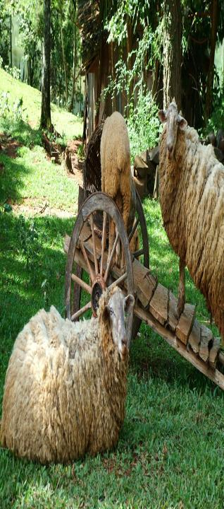
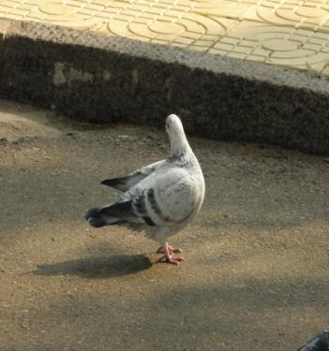
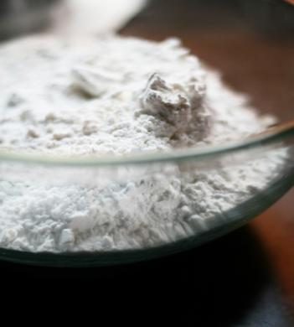

Slide 10
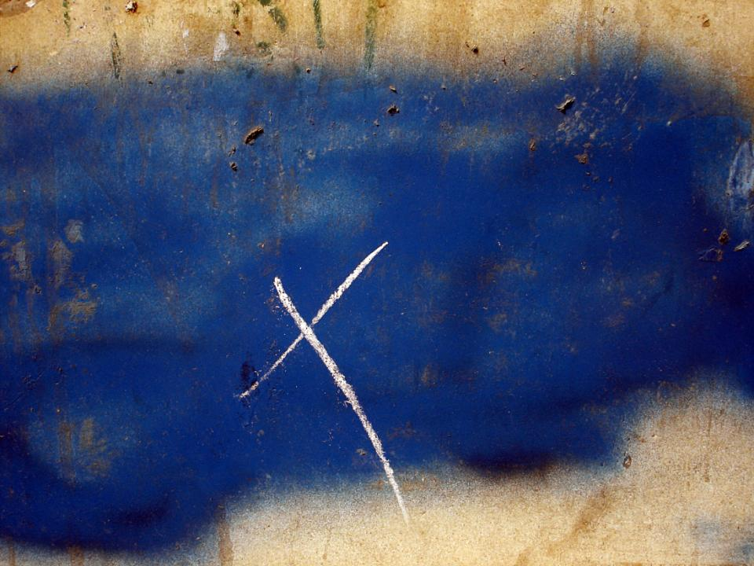

Slide 11
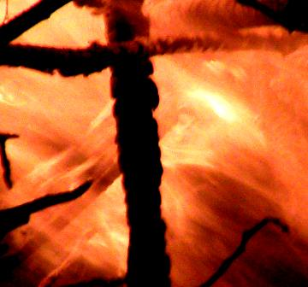

Slide 12
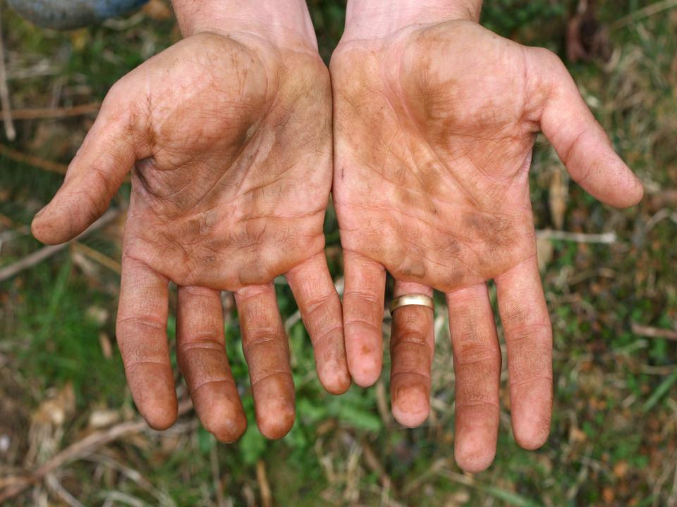
So here’s what I want you to do, God helping you: Take your everyday, ordinary life—your sleeping, eating, going-to-work, and walking-around life—and place it before God as an offering.

