Slide 2
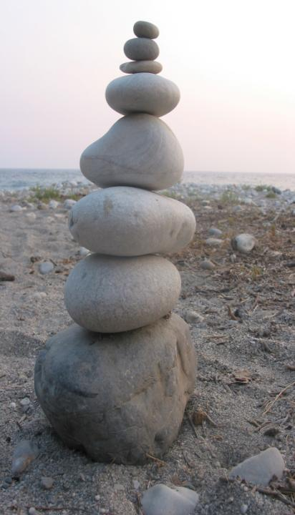
Five Books:
One Message
Genesis
Exodus
Leviticus
Numbers
Deuteronomy

Slide 3
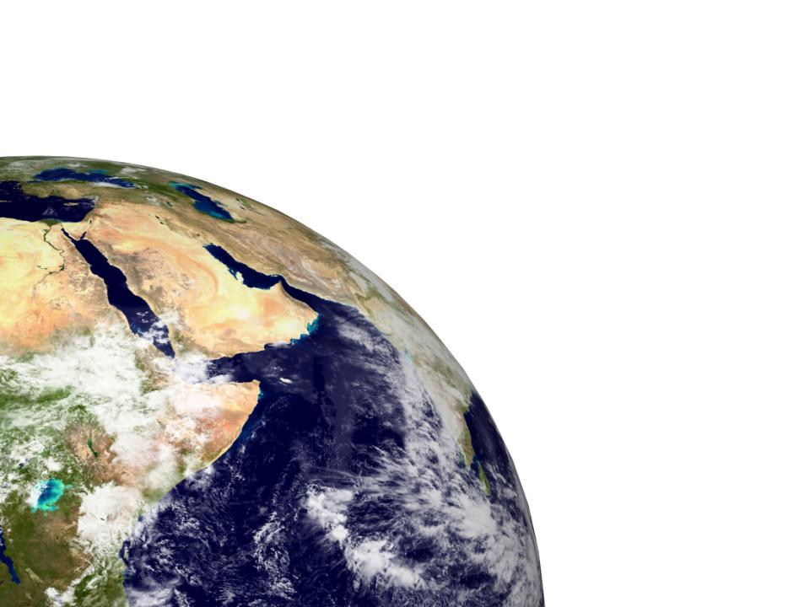
Be holy because I,
the LORD your God,
am holy.
Leviticus 19:2

Slide 4
42‘For the generations to come this burnt offering is to be made regularly at the entrance to the tent of meeting, before the Lord. There I will meet you and speak to you; …..
⁴⁵ Then I will dwell among the Israelites and be their God. ⁴⁶ They will know that I am the Lord their God, who brought them out of Egypt so that I might dwell among them. I am the Lord their God.
Exodus 29

Slide 5
God sets Aaron & sons apart (8)
They make the offering (9)
The Lord answers (9:23-24)
Disaster strikes (10:1-3)
Aaron can’t leave his post (10:6f)

Slide 6
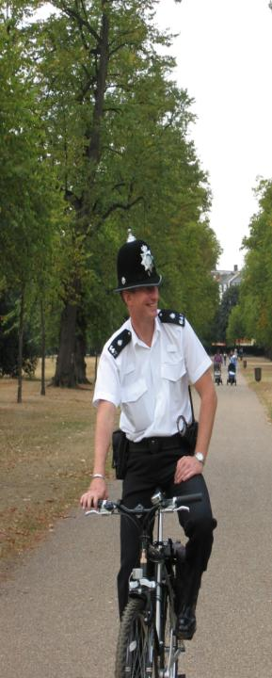
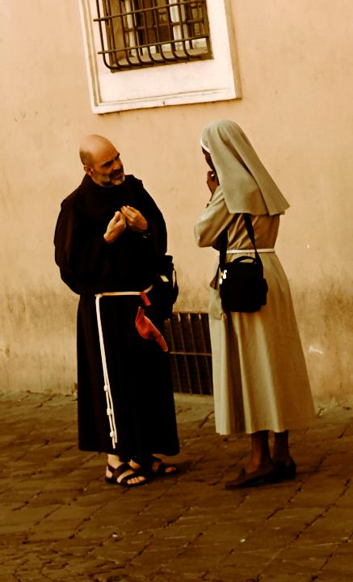
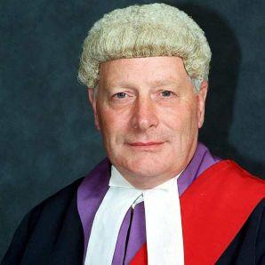

Slide 7
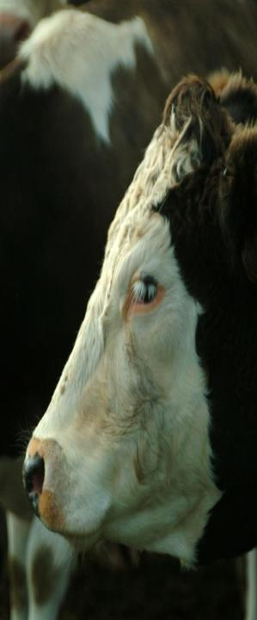
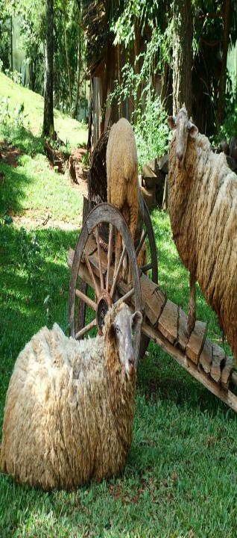
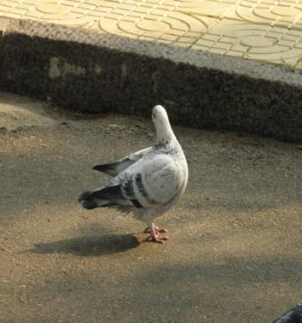
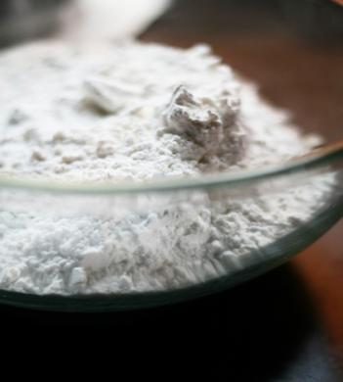

Slide 10
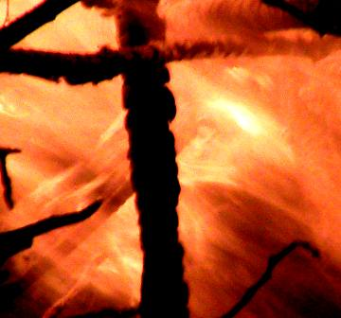

Slide 11
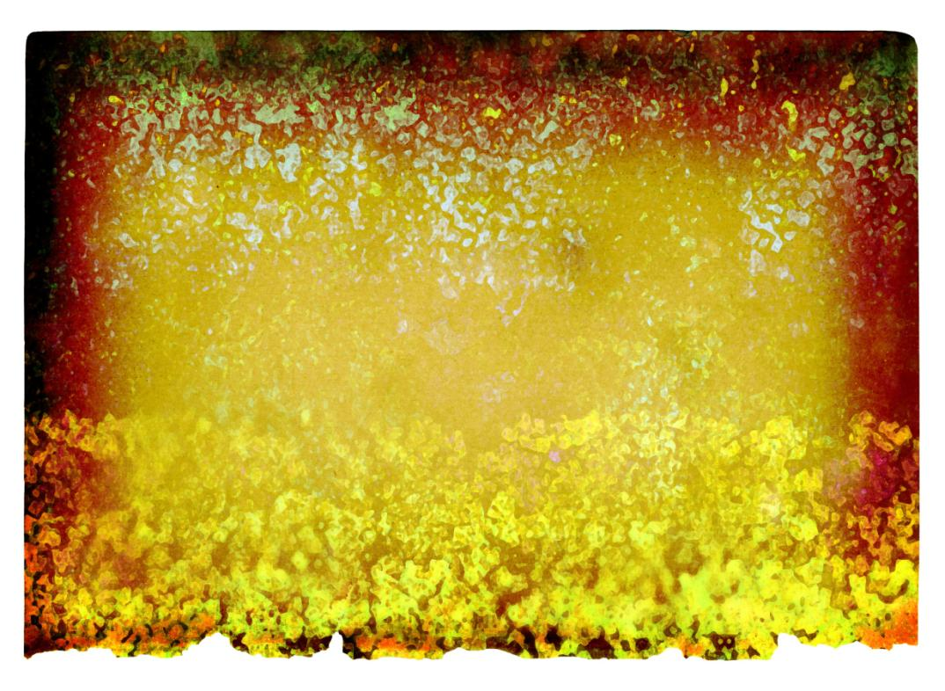
You are a chosen people, a royal priesthood, a holy nation, God’s special possession, that you may declare the praises of him who called you out of darkness into his wonderful light.

Slide 14
