Slide 2
Be holy because I,
the LORD your God,
am holy.
Leviticus 19:2

Slide 3
Close Family
Adultery
Child Sacrifice
Homosexuality
Bestiality

Slide 4
The Lord said to Moses, ² ‘Speak to the Israelites and say to them: “I am the Lord your God. ³ You must not do as they do in Egypt, where you used to live, and you must not do as they do in the land of Canaan, where I am bringing you. Do not follow their practices. ⁴ You must obey my laws and be careful to follow my decrees. I am the Lord your God. ⁵ Keep my decrees and laws, for the person who obeys them will live by them. I am the Lord.

Slide 5
Close Family
Child Sacrifice
Bestiality
Adultery
Homosexuality

Slide 8
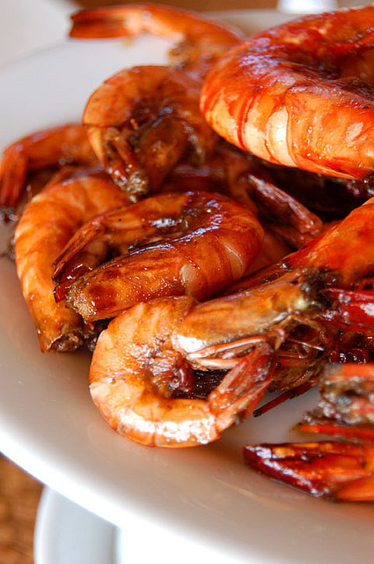
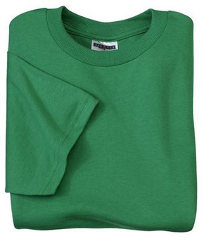

Slide 9
Leviticus 18: 22; 20:13
Romans 1:26-27
1 Corinthians 6:9-11
1 Timothy 1:10

Slide 10
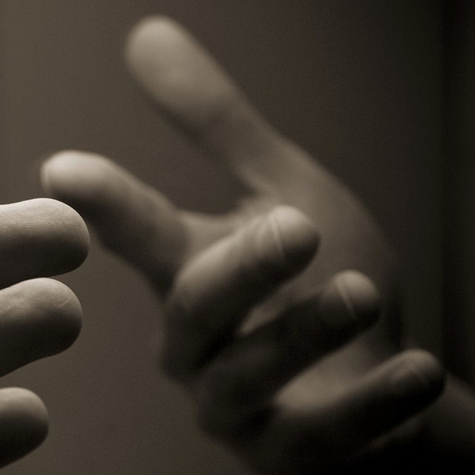
Romans 1
Romans 3:23
Romans 12:1-2

Slide 12
Should we support civil rights?
Can gay people be part of this church?
Is it ok to continue with gay practice?
Will we bless gay marriages?

